Slide 1
Enhancing copies in the Core of Relational Databases
June 15th, 2022

Slide 2
01 – Previous meeting wrap up
02 – Task completion
03 – Current status
04 – Next steps

Slide 3
01
Previous meeting wrap up

Slide 4
Previous meeting wrap up
We have validated the sequential copy process with toy datasets
We have adapted the mathematical framework to handle weighted data

Slide 5
03
Current status

Slide 6
Current Status
01
Complete proof of convergence of the sequential copy process with weighted data
02
Experimental intuition

Slide 7
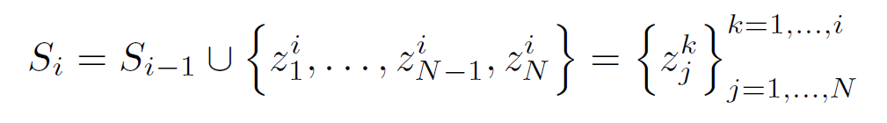
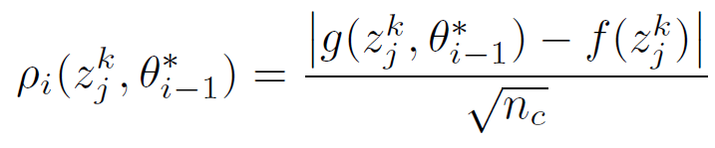
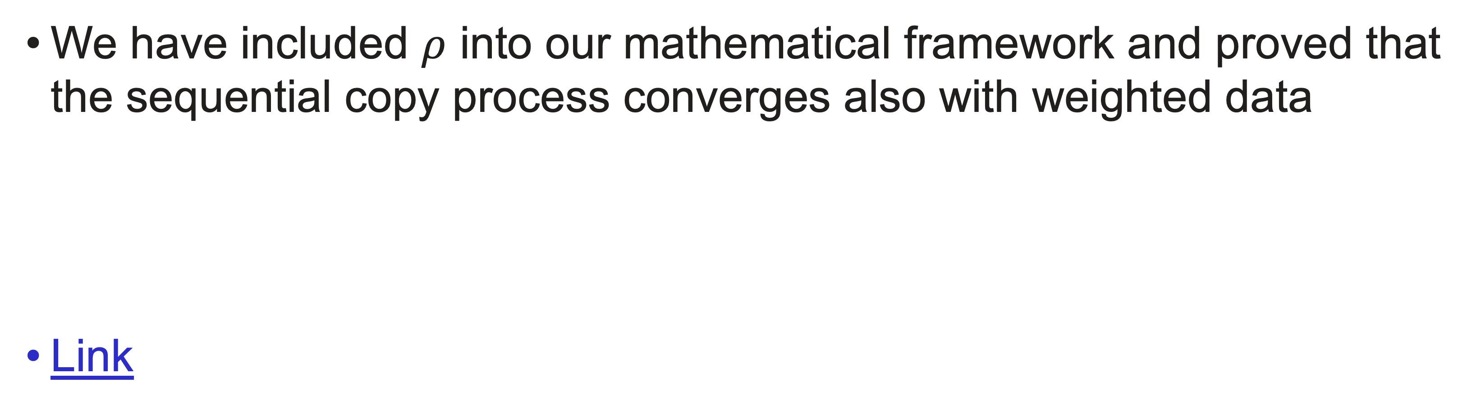
Convergence for weighted data
We have included $ρ$ into our mathematical framework and proved that the sequential copy process converges also with weighted data
Link
The weight, $ρ$, indicates how strong the confidence in the class prediction for each point is.

Slide 8
Current Status
01
Complete prove of convergence of the sequential copy process with weighted data
02
Experimental intuition

Slide 9
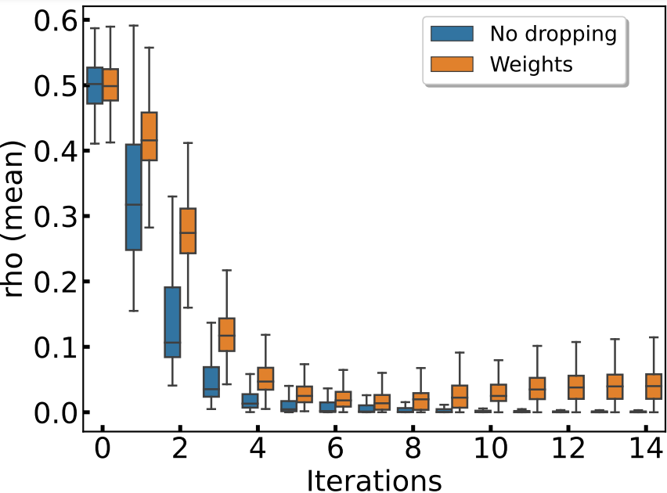
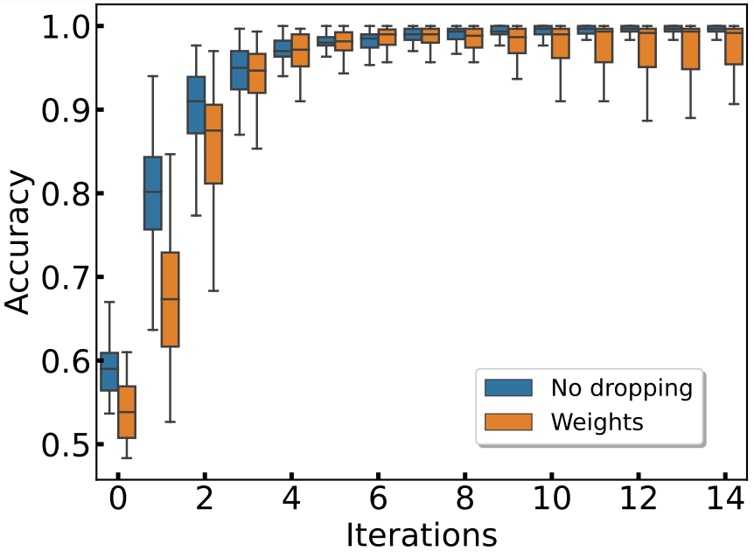
Experimental intuition: no dropping
Unweighted
Weighted
Unweighted
Weighted
Model: Spirals | Sequential + No dropping | Point-dependent weights | 100 runs
N=200 (linear grow)
Copy models converge to a high accuracy

Slide 10
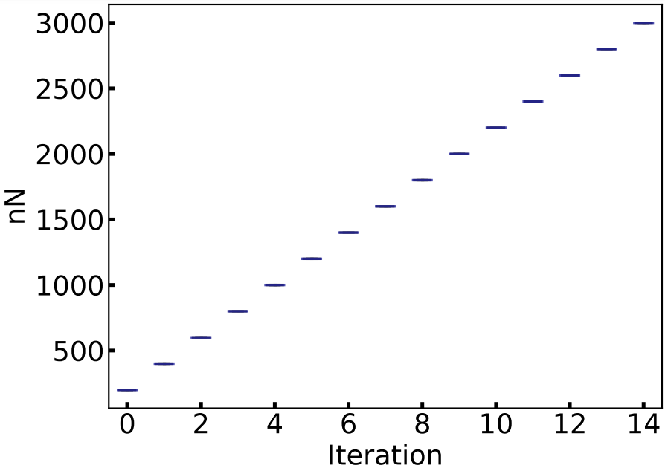
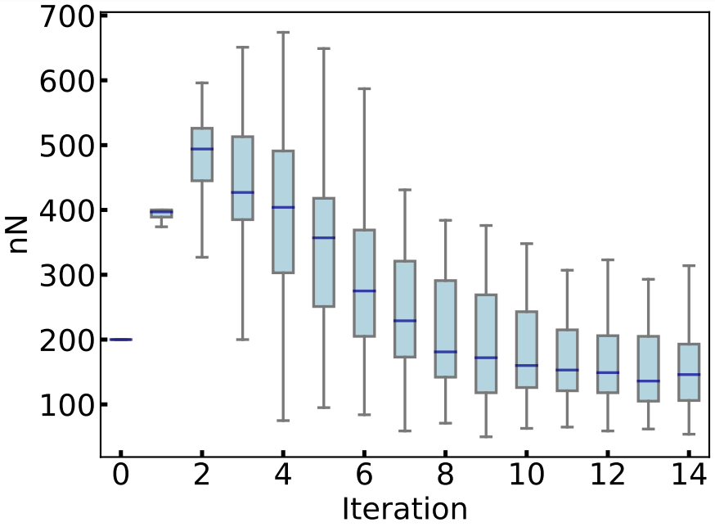
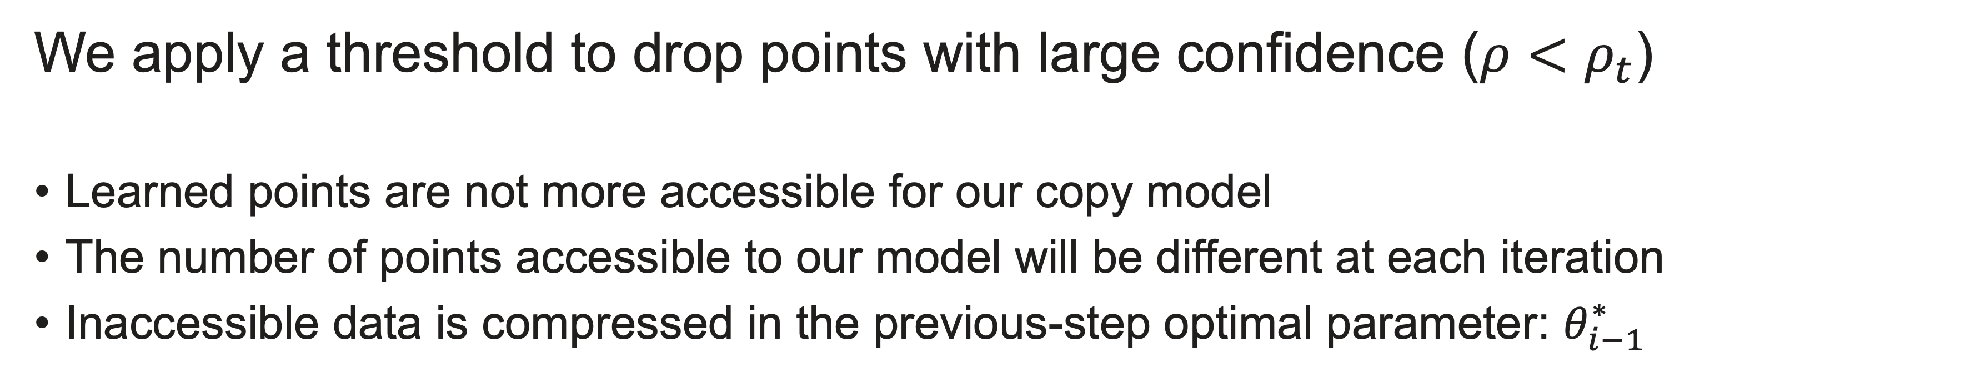
Experimental intuition: dropping
We apply a threshold to drop points with large confidence ($ρ<ρ_{t}$)
Learned points are not more accessible for our copy model
The number of points accessible to our model will be different at each iteration
Inaccessible data is compressed in the previous-step optimal parameter: $θ_{i−1}^{∗}$

Slide 11
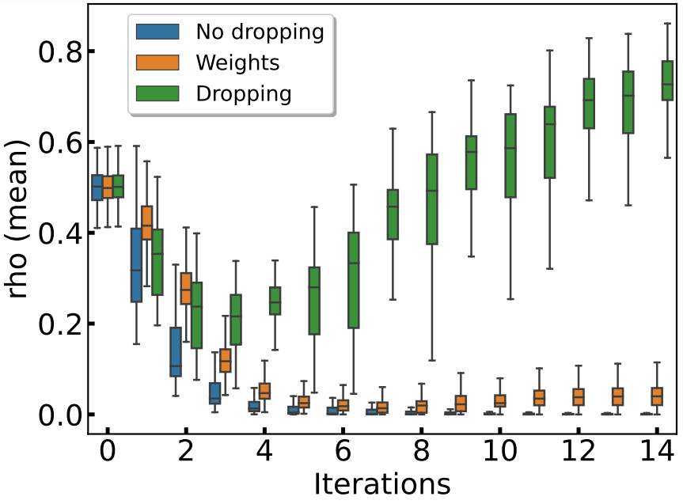
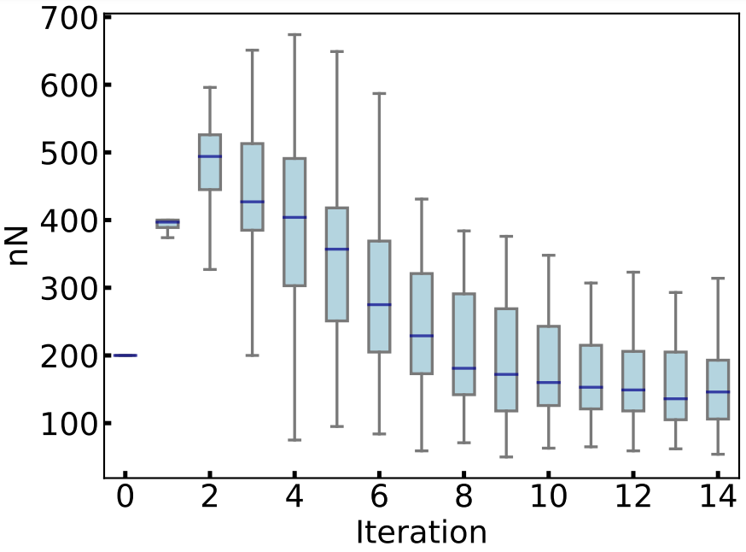
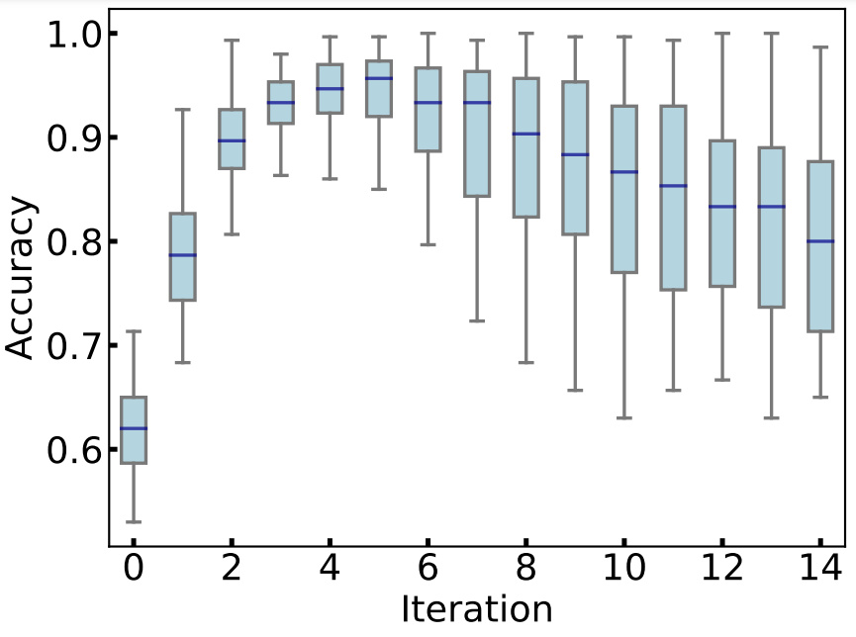
Experimental intuition: dropping
Unweighted
Weighted
Number of points
Is our model forgetting?

Slide 12
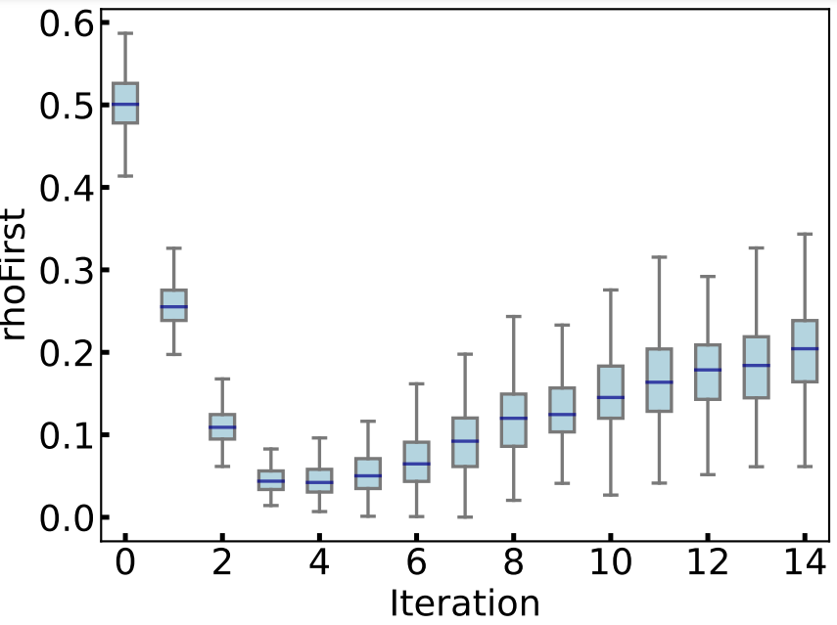
Experimental intuition: forgetting
Sequential copies confidence values for the S₁ points
Number of points
Next steps: undestanding forgetting

Slide 13
04
Next Steps

Slide 14
Next Steps
01
Understanding the forgetting process will give us a better performance for the dropping copies
02
Analyze new datasets and models
03
Write down paper’s draft

